Slide 1
BIT 04103: BLOCK CHAIN TECHNOLOGIES AND APPLICATIONS BLOCK CHAIN PROJECT IDEA
LEC: DR. DENNIS KABURU
Bsc IT_PT: Group Y Members
Stephen Robia 21/06854
James Mutie 21/02299
Everlyne Nyandieka 18/03093

Slide 2
Ideas Proposals
1. Insurance System Using Blockchain Technology
2. Health System Using Blockchain Technology
3. Land System Using Block chain Technology

Slide 3
Demerits of Insurance System Using Block chain Technology
. For the insurance records it will be hard to give exact results
. Needs longer time/period to the develop the systems
. It is expensive in terms of costs/require a lot of resources
. It’s hard to correct system error
. Does not allow modification of data once recorded hence requires rewriting the system code in all of the blocks
Speed and performance-It is slower because requires more operations and also relies on consensus mechanism to validate transaction

Slide 4
Demerits of Health System Using Block chain Technology
. For the health records it will be hard to give exact results
. Needs longer time/period to the develop the systems
. It is expensive in terms of costs/require a lot of resources
. It’s hard to correct system error
. Does not allow modification of data once recorded hence requires rewriting the system code in all of the blocks

Slide 5
Choice of the idea-Due to the increased issues of issuing of land documents and transaction payments the group thought it was wise to come up the land system compared to the other systems.

Slide 6
Merits of Land transaction System Using Block chain Technology
. Avoid forgery of transactions
. Timely update of record details
. To ensure right land owners get instant resource of their request
. Solved voluminous land transactions
. Through reduced redundancy of records
. Security will be enhanced
. It is user friendly

Slide 7
Choice of the programming language and the pros that made us settle on Python.
Cons of using C++:
Steep learning curve: C++ is a complex language with many features and nuances, which makes it challenging for beginners to learn.
Memory management: C++ requires manual memory management, which can lead to errors like memory leaks and segmentation faults.
Limited libraries: While C++ has many libraries, it has far fewer than other languages like Python or Ruby, which limits its ability to leverage existing code.
Code verbosity: C++ code can be verbose, which makes it difficult to read and write compared to other languages like Python or Ruby.
Debugging can be difficult: Debugging C++ code can be more difficult than other languages due to the lack of high-level abstractions.

Slide 8
Cons of using Ruby:
Performance: Ruby is an interpreted language, which can be slower than compiled languages like C++. This can be a disadvantage in performance-critical applications.
Memory consumption: Ruby uses more memory than other languages like C++, which can be a disadvantage in environments with limited resources.

Slide 9
Dynamic typing: Ruby is dynamically typed, which can lead to errors that are not caught until runtime.
Limited multi-threading: Ruby has limited support for multi-threading, which can make it difficult to write concurrent code.
Maintenance issues: Ruby code can be difficult to maintain, especially for large projects, due to its dynamic and flexible nature.

Slide 10
Python;
was the ideal language to use in this project on land blockchain for several reasons:
Ease of use: Python has a simple and easy-to-learn syntax, which makes it an excellent choice for beginners.
Rich set of libraries: Python has a vast collection of libraries that make it easy to perform complex tasks like cryptography and network programming.
Dynamic typing: Python is dynamically typed, which allows for rapid development and makes it easy to write and modify code.
Cross-platform compatibility: Python is a cross-platform language, which means that code written in Python can run on any platform without modification.
Large developer community: Python has a large and active developer community, which means that there is a wealth of knowledge and support available for developers working on Python projects.

Slide 11
Project Proposal: Building a Decentralized Blockchain Network with Access Control for Sharding
Introduction:
Blockchain is a distributed ledger technology that allows secure and transparent transactions without the need for intermediaries. However, as the number of transactions on a blockchain network grows, the network becomes more congested, which can lead to slower transaction times and increased fees. To overcome this issue, sharding is a technique that divides the blockchain network into smaller parts called shards, which can process transactions independently.

Slide 12
The proposed project aims to develop a decentralized blockchain network with access control for sharding. The network will enable multiple nodes to participate in the blockchain network and process transactions independently in different shards. The access control mechanism will ensure that only authorized nodes can participate in a specific shard, which will enhance security and privacy.

Slide 13
Objectives:
To create a secure and transparent land transaction system using blockchain technology.
To provide a decentralized ledger of all land transactions that is tamper-proof and accurate.
To improve the efficiency of the land transaction process by reducing the time and resources required for manual record-keeping.
To provide a user-friendly interface that allows for easy access to the land transaction data.

Slide 14
Literature Review:
Blockchain technology is gaining popularity in various industries, including finance, healthcare, supply chain management, and many others. One of the most important features of blockchain is its decentralization, which eliminates the need for intermediaries and makes the transactions secure and transparent. However, the scalability issue is still a significant challenge for blockchain networks, especially when it comes to processing a large number of transactions.
In our case: Sharding is a technique that aims to solve the scalability issue by dividing the blockchain network into smaller parts called shards. Each shard can process transactions independently, which increases the network's throughput and reduces transaction times. Several blockchain platforms, including Ethereum, Zilliqa, and Harmony, have implemented sharding to enhance their network's performance.

Slide 15
Access control is another crucial aspect of blockchain networks, as it ensures that only authorized nodes can participate in the network. Access control mechanisms, such as permissioned blockchains and smart contracts, have been proposed and implemented in various blockchain platforms.
Current system
The current land transaction management system is inefficient, insecure, and involves middlemen who charge illegal fees. There are also issues with fraud, lack of transparency, and the transfer of property by heredity or will. The proposed solution is a centralized system with a distributed blockchain network for secured and immutable data storage. This system aims to be more efficient, transparent, and accessible to people and all departments. However, the limitation of the proposed system is the centralization of the entire network, which can lead to failure if the central node fails, and privacy concerns for individual nodes.

Slide 16
Proposed Solution:
The proposed project aims to develop a decentralized blockchain network that utilizes sharding to improve scalability and access control to enhance security and privacy. The network will be built using Python and will consist of the following components:
Transaction: A transaction class that represents a transaction on the blockchain network. It will contain the sender's address, receiver's address, and the amount of the transaction.
Block: A block class that represents a block on the blockchain network. It will contain the previous hash, a list of transactions, the timestamp, the nonce, and the shard id.
Blockchain: A blockchain class that represents the entire blockchain network. It will consist of a list of blocks, the difficulty, the transactions pool, the nodes, the shards, and the access control list.
Node: A node class that represents a node in the blockchain network. It will have a unique ID and will be able to participate in the network by processing transactions and adding blocks.
Sharding: A sharding mechanism that will divide the network into smaller parts called shards. Each shard will be responsible for processing transactions independently.
Access Control: An access control mechanism that will ensure that only authorized nodes can participate in a specific shard.

Slide 17
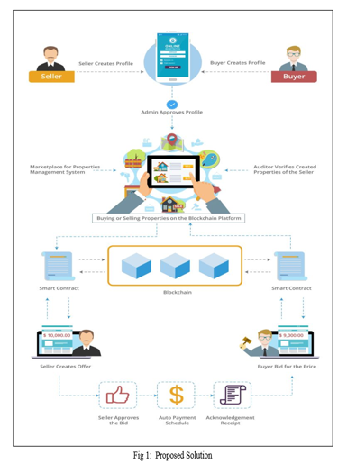

Slide 18
Technical Implementation:
The system will be built using a combination of block chain technology and a relational database
(MySQL). The block chain will provide the secure and transparent recording of all land transactions, while the database will be used to store and retrieve the land data. The system will also include a user-friendly web interface that will allow users to access the land transaction data and perform transactions.
The project will be implemented in Python and will make use of the Django framework for the web interface.

Slide 19
Hashing Implementation
Hashing is implemented using the SHA-256 algorithm from the hashlib library. In details;
The get_hash() method in the Block class takes the data of the block (previous hash, transactions, timestamp, nonce, and shard ID) and concatenates them into a string.
The concatenated string is then encoded as bytes and passed to the SHA-256 algorithm from the hashlib library to generate an inner hash.
The inner hash is then encoded again as bytes and passed to the SHA-256 algorithm to generate the outer hash. The outer hash is then returned as the hash of the block.

Slide 20
class Block:
def __init__(self, previous_hash, transactions, timestamp, nonce, shard_id):
self.previous_hash = previous_hash
self.transactions = transactions
self.timestamp = timestamp
self.nonce = nonce
self.shard_id = shard_id
self.hash = self.get_hash()
def get_hash(self):
transaction_data = "".join([str(tx.sender) + str(tx.receiver) + str(tx.amount) for tx in self.transactions])
header_bin = (str(self.previous_hash) + transaction_data + str(self.timestamp) + str(self.nonce) + str(self.shard_id)).encode()
inner_hash = hashlib.sha256(header_bin).hexdigest().encode()
outer_hash = hashlib.sha256(inner_hash).hexdigest()
return outer_hash

Slide 21
Encryption Implementation
Encryption is the process of converting plain text into cipher text to secure the data from unauthorized access. Encryption will be implemented using the the Advanced Encryption Standard (AES) algorithm.
To implement AES encryption in the code, the "cryptography" library will be used. First, the library will need to be installed using pip install cryptography. Then, the following snippet will be be added to the existing code to encrypt and decrypt the transactions:
Fernet module is used to generate a key for encryption and decryption. The encrypt() and decrypt() methods are added to the Transaction class, which encrypt and decrypt the plain text using the Fernet key.

Slide 22
Continued;
To encrypt the data, the encrypt() method is called with the plain text as a parameter. It encrypts the plain text using the Fernet key and returns the encrypted data in cipher text format. Similarly, the decrypt() method is called to decrypt the data, which takes the cipher text as a parameter and returns the decrypted plain text.
By implementing encryption, the transactions can be securely stored in the blockchain and can only be accessed by authorized nodes that have the decryption key.

Slide 23
from cryptography.fernet import Fernet
# Generate a key for encryption and decryption
key = Fernet.generate_key()
class Transaction:
def __init__(self, sender: str, receiver: str, amount: float):
self.sender = encrypt(sender)
self.receiver = encrypt(receiver)
self.amount = encrypt(str(amount))
def encrypt(self, text):
f = Fernet(key)
return f.encrypt(text.encode()).decode()
def decrypt(self, text):
f = Fernet(key)
return f.decrypt(text.encode()).decode()

Slide 24
Project Schedule:
The project is estimated to take a total of 8-12 weeks to complete, including testing and deployment. The following is a rough schedule for the project:
Week 1-2: Requirements gathering and project planning
Week 3-4: Blockchain implementation and integration with the database
Week 5-6: Development of the web interface using the Django framework
Week 7-8: Testing and debugging of the system
Week 9-12: Deployment and user training

Slide 25
To implement ownership, we will use cryptographic hashing to ensure that only authorized nodes can add new blocks to the blockchain. The Block class has a get hash method that calculates the hash of a block header. This hash is used to verify that the block has not been tampered with and that the node adding the block has the necessary authorization. The mine_block method uses the Hash cash algorithm to ensure that adding a new block to the blockchain requires a significant amount of computational work, which makes it difficult for an attacker to modify the blockchain.
Additionally, the code defines the Transaction class, which stores the sender's and receiver's addresses and the transaction amount. This information is used to calculate the transaction data, which is included in the block header when calculating the hash of the block. This ensures that the transaction data is immutable and cannot be modified after being added to the blockchain.
We will achieve ownership in the blockchain through shard-level access control, cryptographic hashing, and encryptions and the Hashcash algorithm. These measures ensure that only authorized nodes can add new blocks to the blockchain, and the data stored in the blockchain is immutable and tamper-proof.

Slide 26
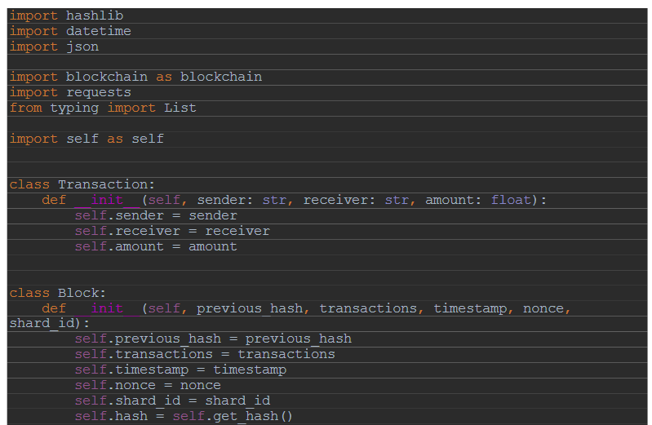
System Code

Slide 27
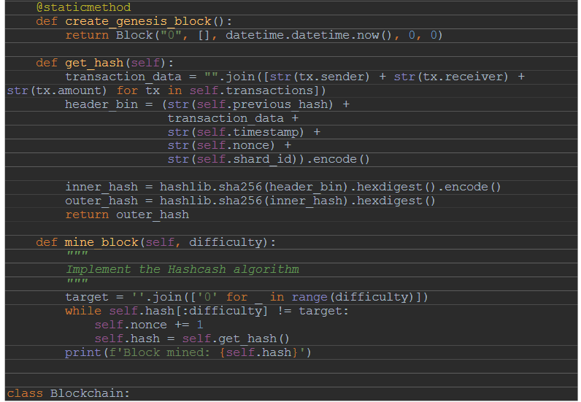

Slide 28
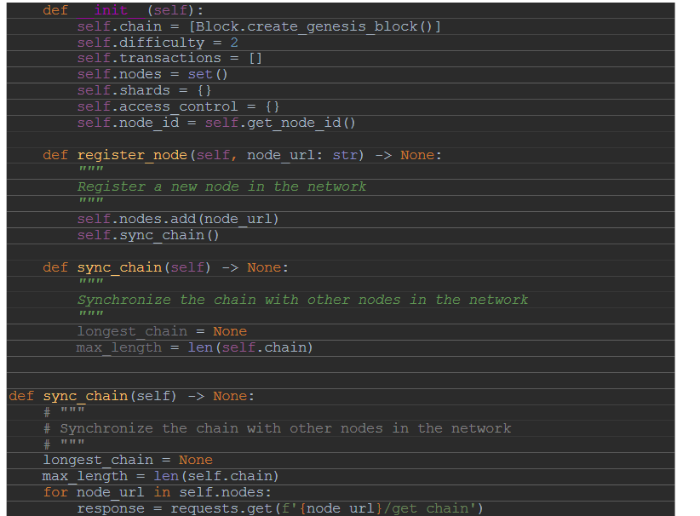

Slide 29
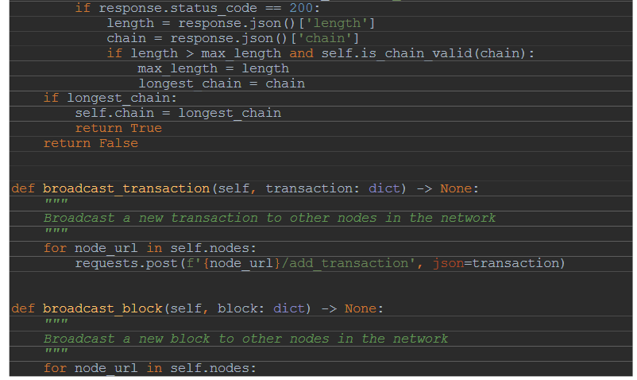

Slide 30
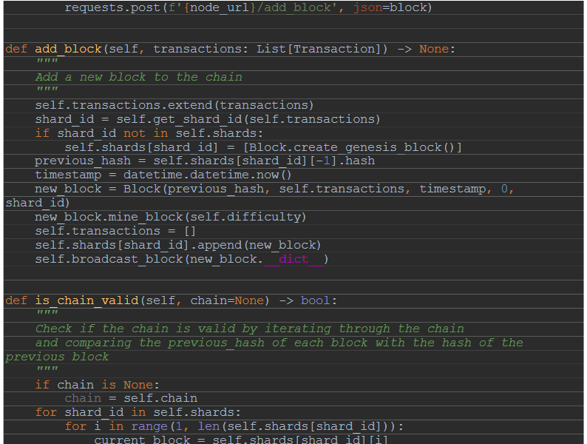

Slide 31
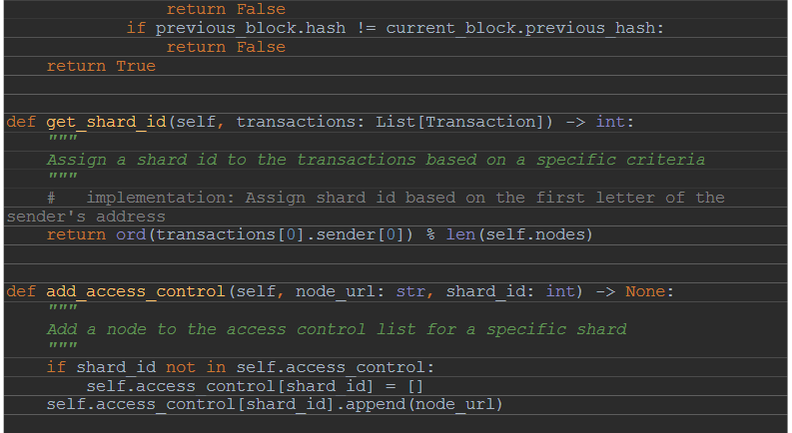

Slide 32
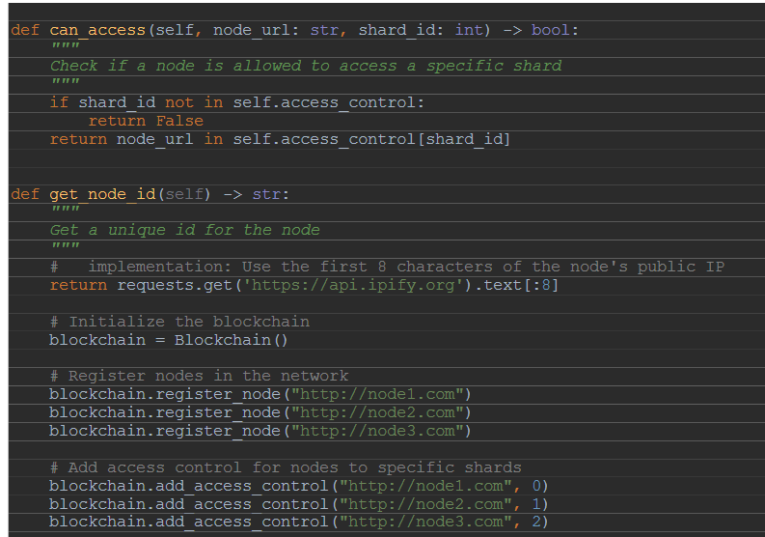

Slide 33
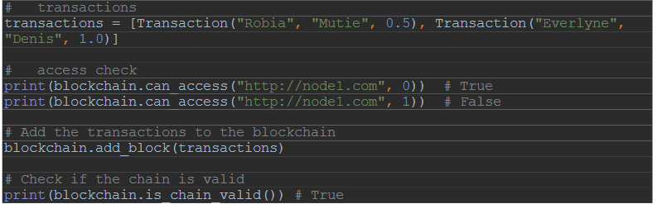

Slide 34
References
Gaikwad, D., Hambir, A., Chavan, H., Khedkar, G., & Athawale, D. (2022). Real Estate Land Transaction System Using Blockchain. International Journal For Research In Applied Science And Engineering Technology, 10(3), 307-311.
Nandi, M., Bhattacharjee, R. K., Jha, A., & Barbhuiya, F. A. (2020). A secured land registration framework on Blockchain. In 2020 third ISEA conference on security and privacy (ISEA-ISAP) (pp. 130-138). IEEE.
Mishra, I., Sahoo, A., & Anand, M. V. (2021, March). Digitalization of Land Records using Blockchain Technology. In 2021 International Conference on Advance Computing and Innovative Technologies in Engineering (ICACITE) (pp. 769-772). IEEE.

